Slide 1
Unrecognized states

Slide 2
China vs Taiwan
Brief history
China has tried to take over Taiwan several times
The island has tried to keep its independence but struggles with large, powerful china
What happened?
After WWII, Taiwan was given to China and “republic of china”
Eventually, united nations would claim that Taiwan was a part of china and removed “republic of china” from their meetings

Slide 4
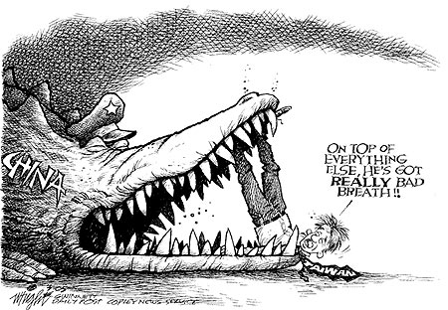
China vs Taiwan
Problems today
Taiwan continues to fight with china over its independence, claiming to be its own STATE
United nations does not support Taiwan due to china’s status (Does not want to offend China)

Slide 5
Kosovo vs. Serbia
Brief History
Both Serbia and Kosovo were part of a larger country until 1991
When the country broke up, Kosovo wanted independence from Serbia Which ended in war the U.N. would have to stop
What happened?
In 2008, Kosovo’s government decided to become its own state and separated from Serbia
Many countries (Like USA, UK, and Germany) recognized Kosovo’s independence
Russia, Serbia’s ally, chose to reject Kosovo’s independence

Slide 7
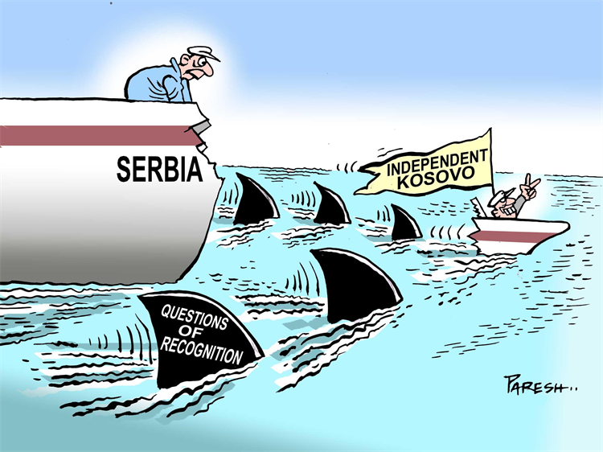
Kosovo vs Serbia
Problems today
Most countries in Europe agree that Kosovo is independent from Serbia
However, they’re not an ‘official’ country until Russia allows them into the United nations (No one wants to annoy Russia)

Slide 8
Palestine vs Israel
Brief History
Palestine is in the Middle East. Home to Christians, jews, and muslims
Jews and Palestinians fight in the region due to land claims
What happened?
In 1948, United nations gives Jewish population rights to create new country of Israel
Israel would claim more land in the 1960s to extend its borders, causing more war

Slide 10
Palestine vs Israel
Problems today
Palestine is not recognized currently as Israel is a member of the united nations., UN usually sides with Israel
However, if fighting stops and a peaceful resolution is made, UN will help Palestinians create new country

