Slide 1
Unit 6 Vocab List

Slide 2
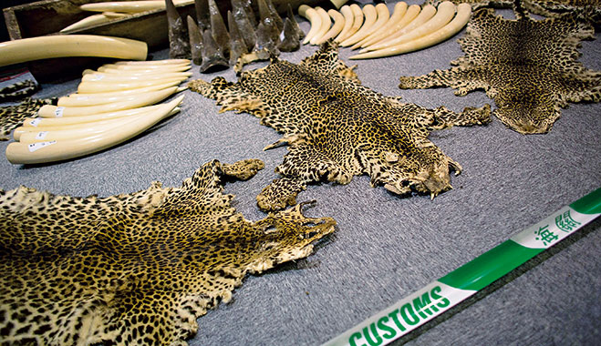
Black Market
The buying and selling of goods in violation of legal rules & controls
Example: Illegal animal poaching

Slide 3
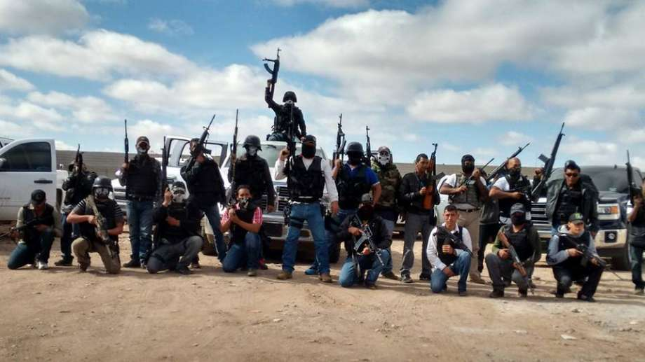
Cartels
Often informal international association formed to regulate prices and output in a certain product or business
Example: Juarez Cartel in Mexico selling drugs, guns, and people

Slide 4
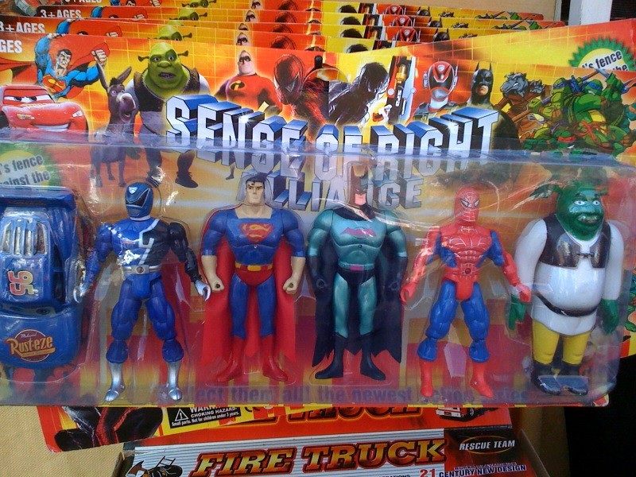
Counterfeiting
Creating something to be passed off fraudulently as something genuine
Example: Fake money, selling fake goods during the holiday

Slide 5
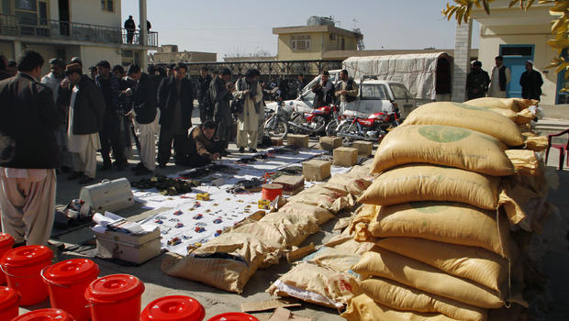
Drug Trade
The trade of illegal drugs, usually involving a suppling country and a demanding country
Example: Colombian Drug Cartels smuggle cocaine into demanding countries

Slide 6
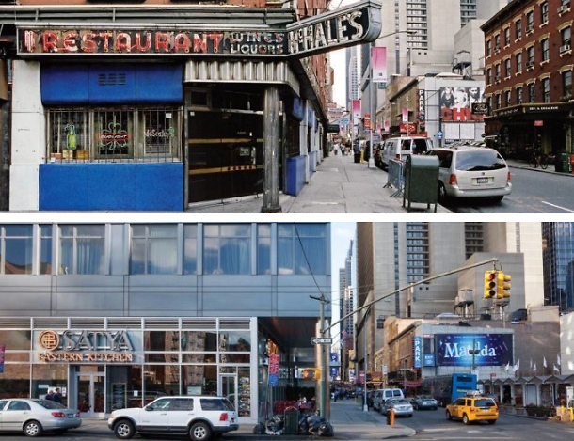
Gentrification
Process of converting an urban neighborhood from a mostly low income renter occupied area to a mostly middle class owner occupied area
Example: Vancouver, Canada. New York City, USA

Slide 7
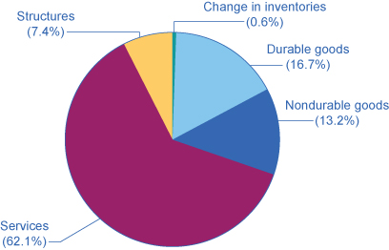
Gross Domestic Product (GDP)
The value of the total output of goods and services produced in a country in a year
Example: In 2017, the U.S. GDP was $19.3 Trillion

Slide 8
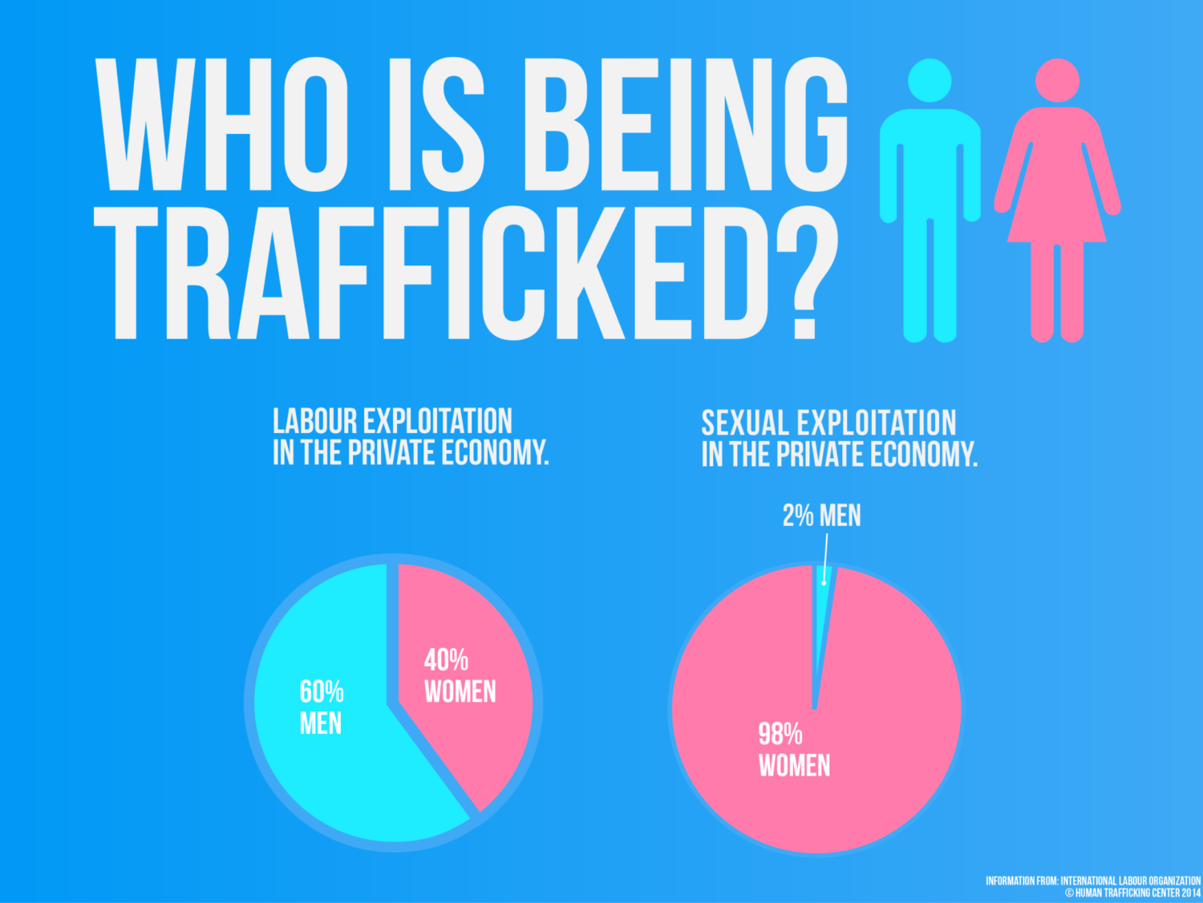
Human Trafficking
The illegal practice of trading human beings for the purpose of exploitation like prostitution or forced labor
Example: African children were abducted and forced to work in diamond mines in West Africa

Slide 9
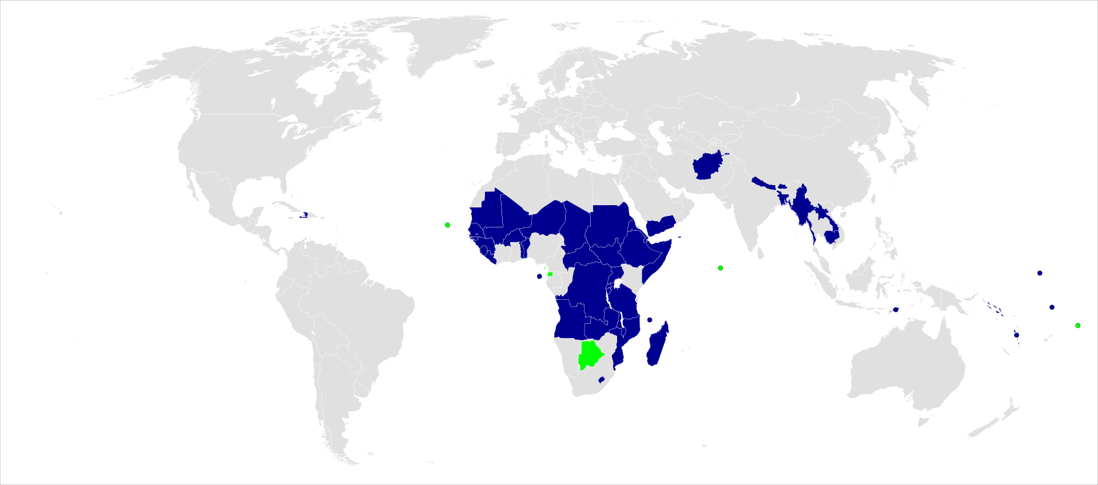
Less Developed Countries (LDC)
A country that is at a relatively early stage in the process of economic development
Example: 33 countries in Africa are considered Lesser Developed than other countries worldwide

Slide 10
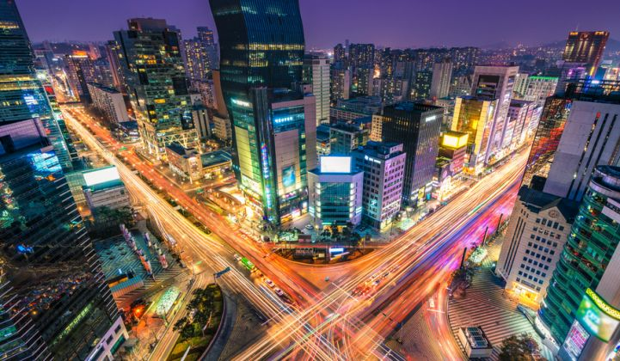
Megacities
A city with a population of 10 million or more
Example: Atlanta, NYC, San Francisco

Slide 11
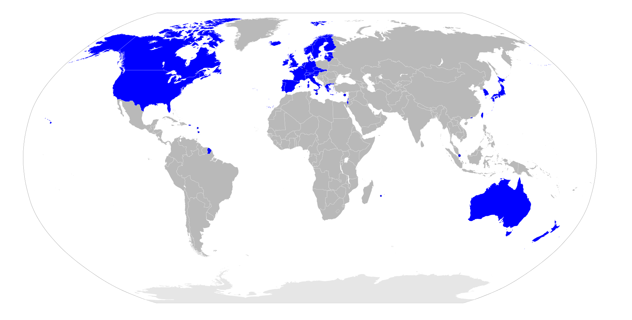
More Developed Countries (MDC)
A country that is in the later stage in the process of economic development
Example: Almost all of Europe is developed

Slide 12
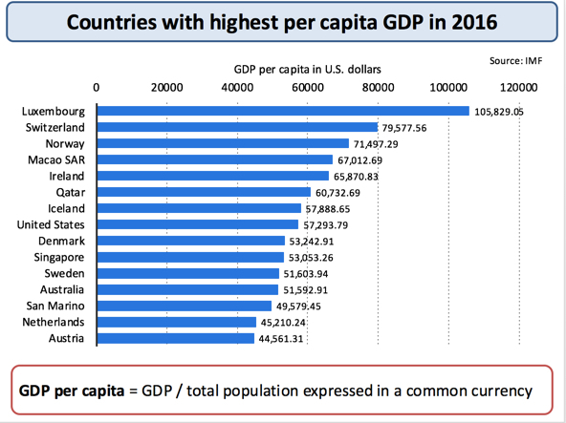
Per Capita GDP
Approximately how much a person in a country would make in a year calculated by dividing the GDP by the population
Example: US GDP (13.9 Trillion)/ US Pop. (326 Million)=$42,638.36 (Roughly)

Slide 13
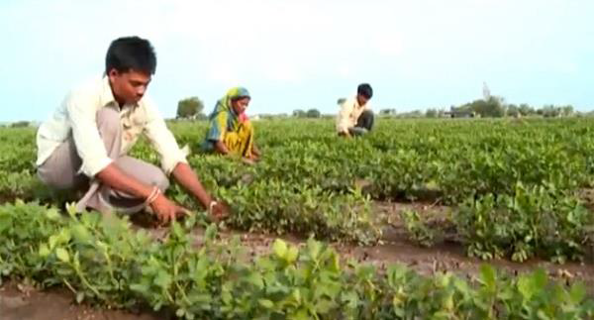
Primary Sector
Portion of the economy in which raw materials are extracted from the earth
Example: Farming, Fishing, Mining

Slide 14
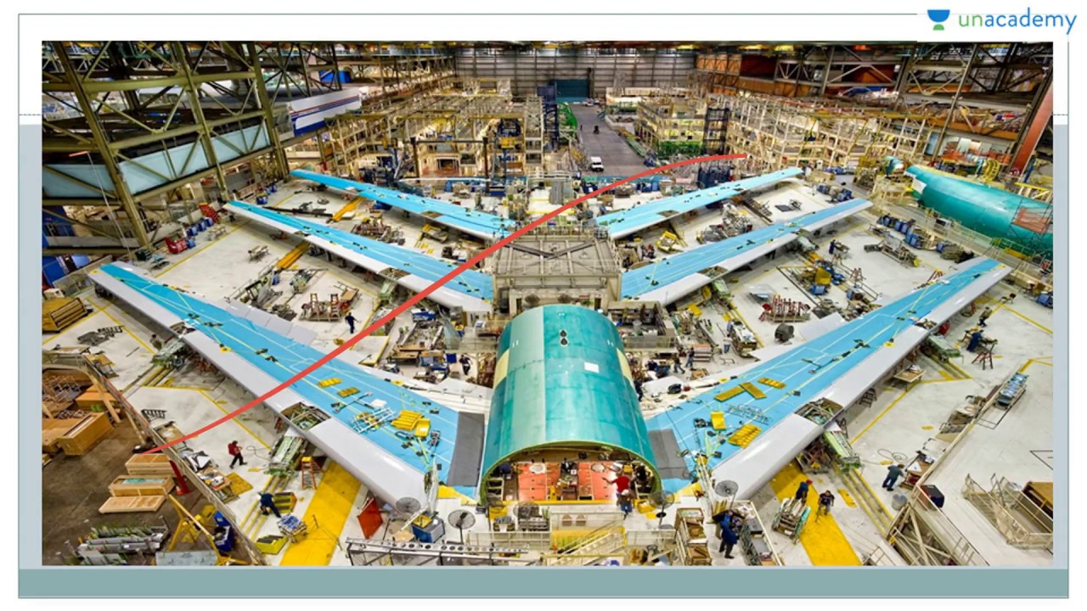
Secondary Sector
Portion of the economy where raw materials are turned into useful products like manufacturing, processing, or assembling raw materials
Example: Factory Jobs, Assembly Plants, Oil Refining

Slide 15
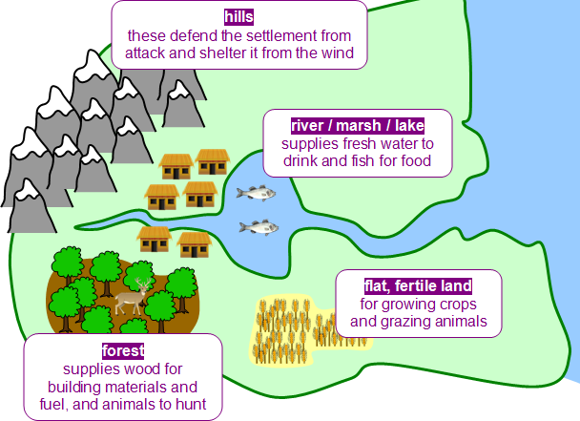
Site
Physical characteristic of a place (climate, topography, vegetation)
Example: South Georgia benefits from flat land to farm and raise cattle

Slide 16
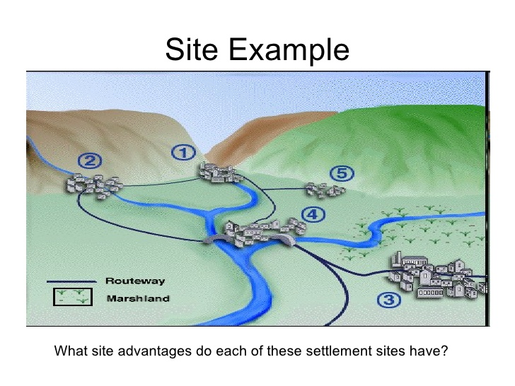
Situation
Location of a place on Earth relative to other places
Example: North Georgia is mountainous. South Georgia is flat plains

Slide 17
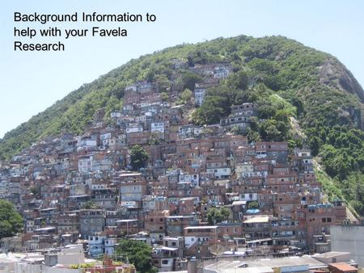
Squatter Settlement
Area within a city, usually a LDC, where people establish residences on land they do not own or rent
Example: The Favela’s in Brazil

Slide 18
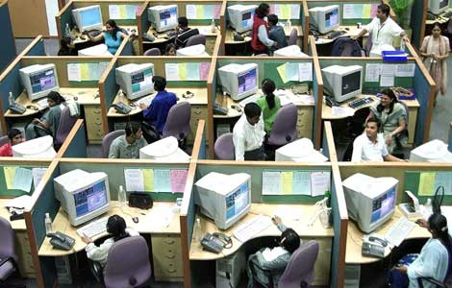
Tertiary Sector
Portion of the economy concerned with transportation, communication, utilities, and services in exchange for payment
Example: Working at McDonalds, Driving a Bus, Teaching, Police

Slide 19
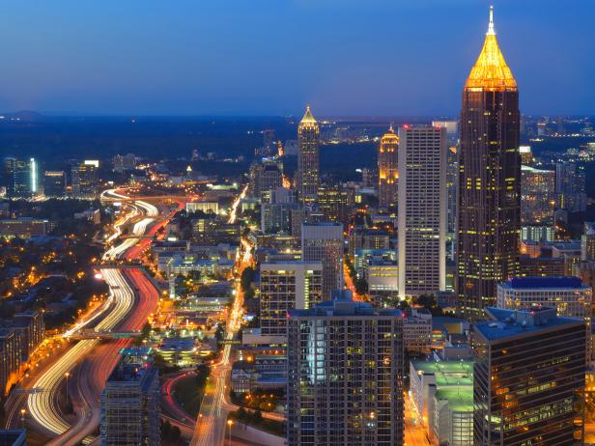
Urban Sprawl
The rapid, often poorly planned spread of development from an urban area outward into rural areas
Example: Atlanta is considered ‘Sprawlanta’ for its poorly planned city layout

Slide 20
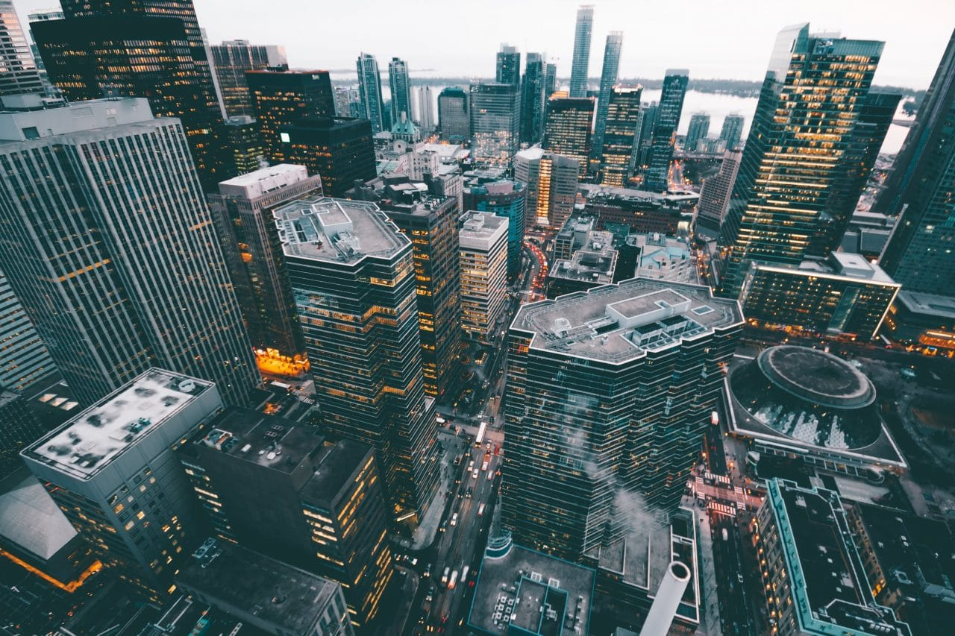
Urbanization
The growth of areas into cities
Example: Savannah turning from a small port into a larger city

