Slide 1
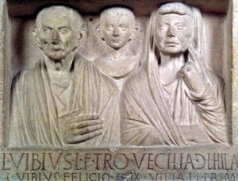
The Roman Republic

Slide 2
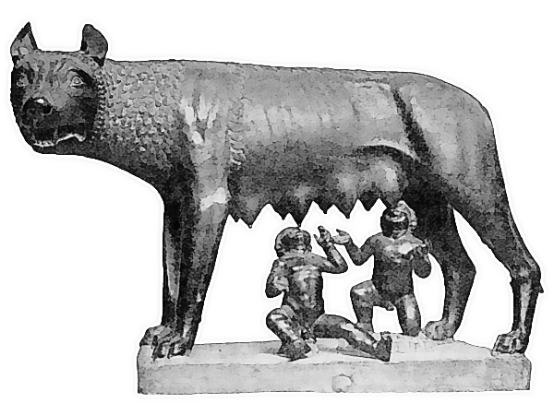
How was Rome founded?
Legend says…
Rhea was a princess and a mortal woman who was married to Mars, the Roman god of war. Rhea and Mars had twin sons and named them Romulus and Remus. An evil uncle took them as babies from their mother and threw them into the River Tiber to drown. The babies floated to land, and a mother wolf fed and cared for them. Later a herdsman looked after the twins until they grew up…

Slide 3
How was Rome founded?
Legend says…
Years later, Mars told his twin sons to build a city where they had been found. The city was Rome. One day, Remus made fun of the wall Romulus had built around the city. The twins argued, fought, and Romulus killed Remus. Today, historians and archaeologists agree that people were living in Rome long before 753 BC, but the legend is one of the most famous in world history.

Slide 4
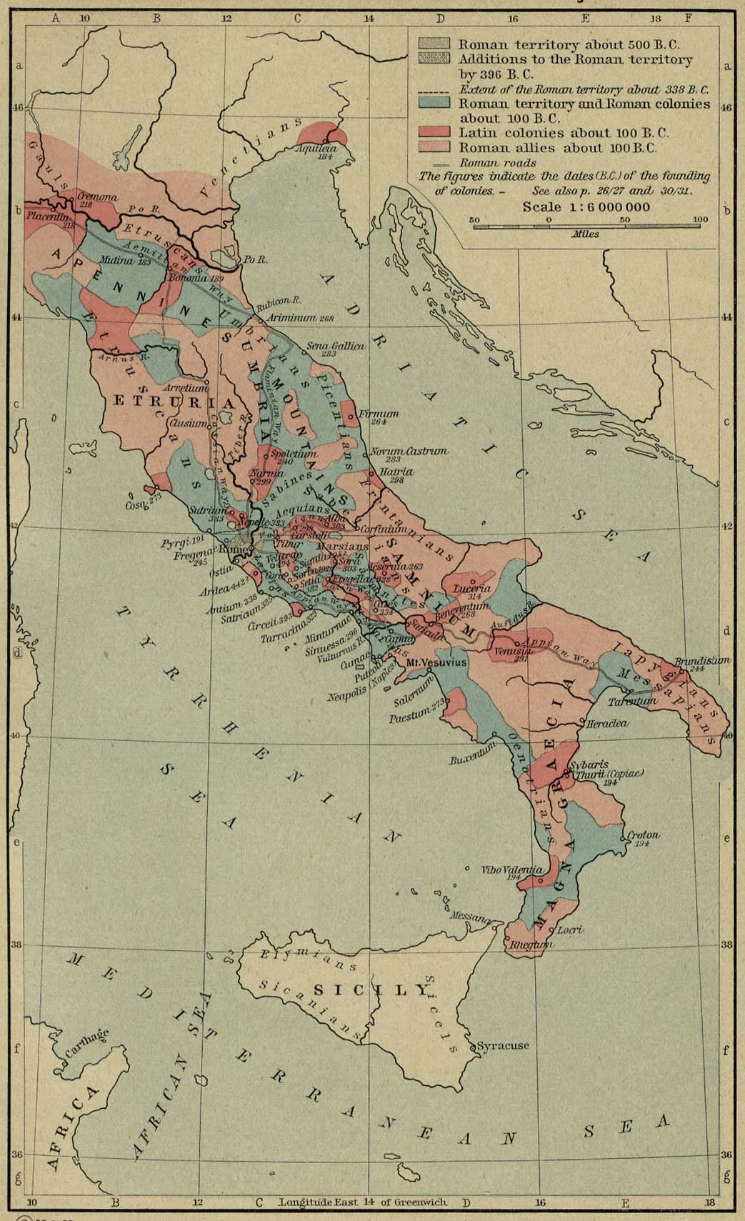
Geography

Slide 5
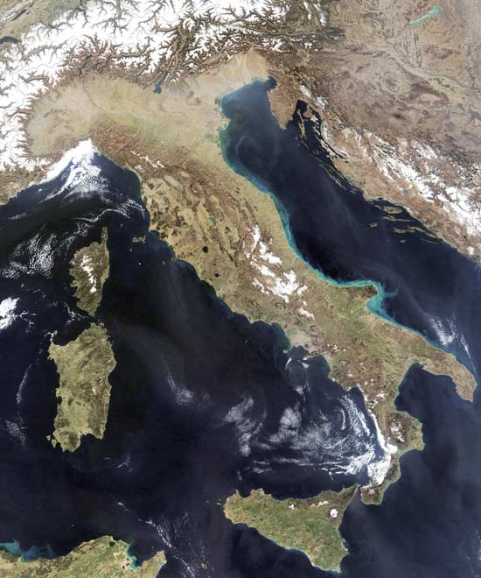
Geography
Italy is a peninsula that extends into the Mediterranean Sea
Rome develops on the Tiber River
Fertile soil & strategic location

Slide 6
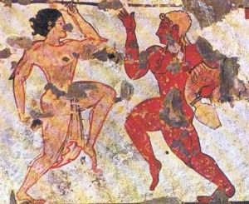
The Early People of Italy

Slide 7
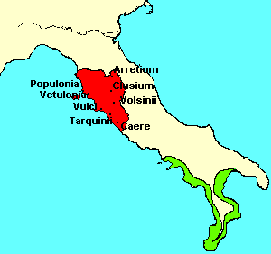
Early Peoples
The Etruscans:
Ruled in northern Italy from 900 BC to 500 BC
Heavily influenced the ancient Romans

Slide 8
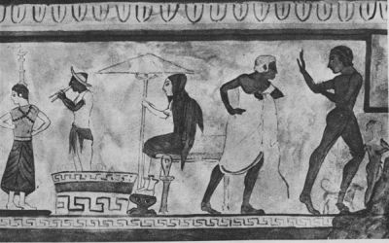
Early Peoples
Influences:
The usage of brick
Construction of city streets
Creation of the FORUM
Religious beliefs

Slide 9
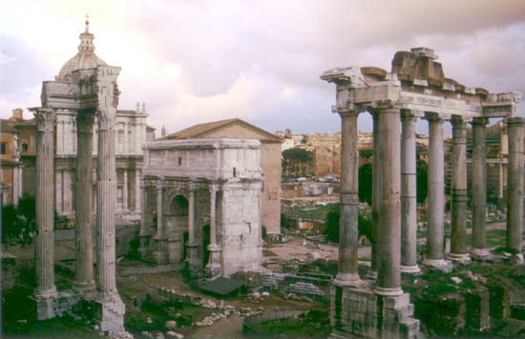
Ancient Rome

Slide 10
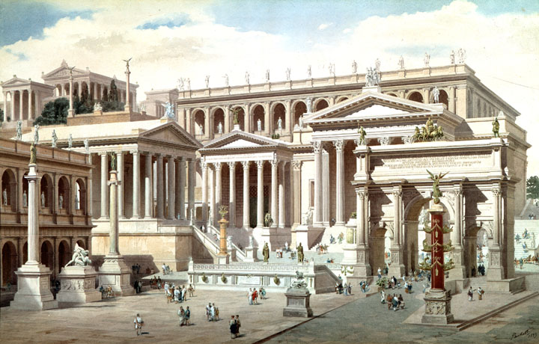
Hypothetical reconstruction of Roman Forum
Watercolor (18th century), Giuseppe Becchetti

Slide 11
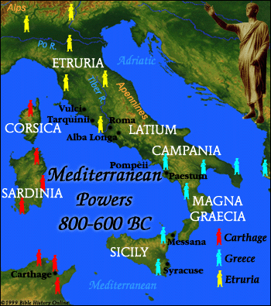
Early Peoples
Latins:
First settlers of Rome (1000 BC)
Notes:
It was in Latium that an Indo-European group, the Latins, (ancestors of the Romans) migrated and settled near the Tiber River. Their first city, called Alba Longa, was built about 1000 BC. Their most important city, Rome, was founded in 753 BC by Romulus

Slide 12
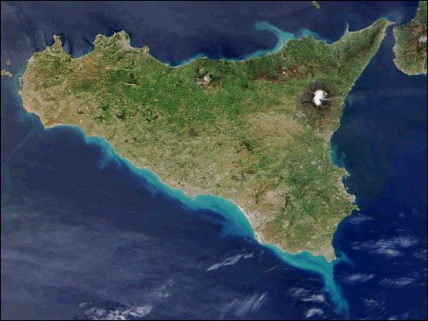
Early Peoples
Greeks:
Settled in southern Italy on the island of Sicily
Influence on Romans:
Art, architecture, literature, government, engineering

Slide 13
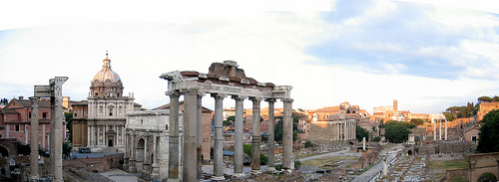
The Republic

Slide 14
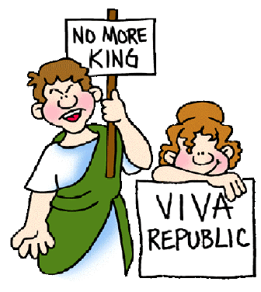
No More Kings
509 B.C., Romans rejected Etruscan king (monarchy) and established a republic

Slide 15
No More Kings
Power rests with the citizens who have the right to vote for their leaders
In Rome, citizenship with voting rights was granted only to free-born male citizens

Slide 16
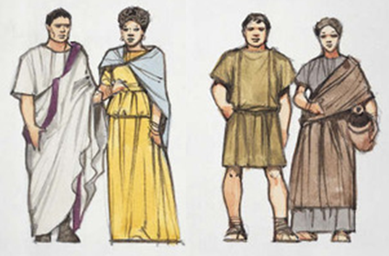
Social Classes

Slide 17
Social Classes
Citizens of Rome divided into 2 classes:
Patricians & Plebeians

Slide 18
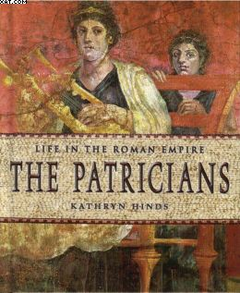
Social Groups
PATRICIANS:
Wealthy landowners who held most of the power
Inherited power and social status

Slide 19
Social Groups
PLEBEIANS:
Common farmers, artisans and merchants who made up the majority of the population
Can vote, but can’t rule (in the beginning)
Notes:
BOTH Patricians & Plebeians could: Be citizens, Vote, Pay taxes, Join the army

Slide 20
Social Groups
We commoners really need to have someone to represent us! Maybe they will listen to us soon…
It’s great being wealthy and powerful!
Notes:
BOTH Patricians & Plebeians could: Be citizens, Vote, Pay taxes, Join the army

Slide 21
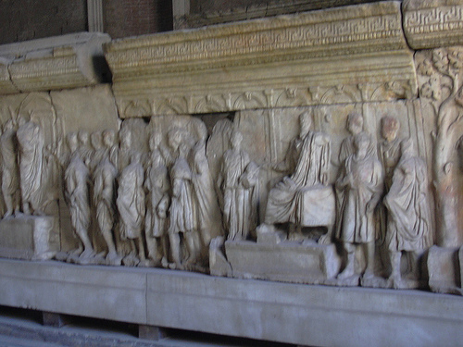
A “Balanced Government”

Slide 22
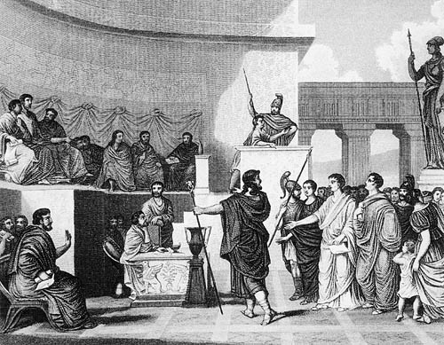
Senate
Senate:
The “Legislative” Branch
Chosen from patricians
Make foreign and domestic laws

Slide 23
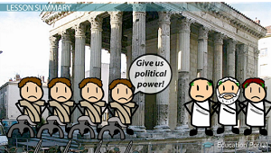
Tribunes
499 BC:
Plebeians refused to fight in the Roman army unless they were given more POLITICAL POWER
Patricians agreed to grant more power to the Plebeian class by establishing the TRIBUNE…

Slide 24
Tribunes
TRIBUNES:
Elected representatives of popular assemblies who protect plebeians’ political rights
Make laws for plebeians (commoners)

Slide 25
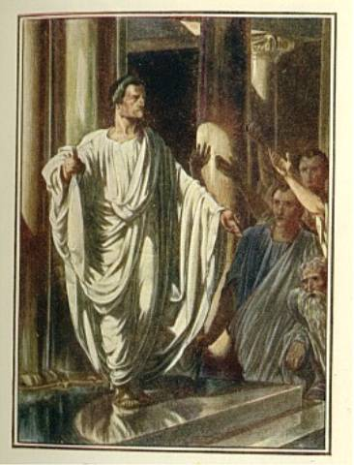
Consuls
Consuls:
The “Executive” Branch
Rome elects 2 senators to rule for 1 year
1 to lead the army
1 to lead the government

Slide 26
Dictators
Dictators:
Leaders appointed briefly (6 months) in times of crisis
Appointed by consuls and senate

Slide 27
The Twelve Tables
451 B.C., officials carve Roman laws on twelve tablets and hung in Forum
Laws confirm right of all free citizens to protection of the law
Become the basis for later Roman law

Slide 28
Making Connections…
How does the government of the U.S. compare to that of the Roman Republic? Consider each of the following…
Legislative Branch?
Executive Branch?
Judicial Branch?
Voters?
Citizenship?

