Slide 1
Site & Situation
Subtitle

Slide 2
Site Factors
For most businesses (in the secondary sector), they have to think of 3 things when they build a factory—land, labor, and capital.
Land: Where do I build my factory?
  What are physical features that will impact me?
  Where is land cheap?
  Am I too far from what I need?
Labor: Who will work in my factory?
  Do I want cheap unskilled labor or skilled labor that costs me more?
  Am I willing to pay for benefits like insurance and vacation time?
Capital: How much money do I need for my business?
  Do I want people to be stock buyers?
  How can I make my business attractive to people?
  Will I be profitable?

Slide 3
Situation Factors
Situation factors are factors that involve getting your product from your factory to the market (where there are enough people willing to buy it).
Transportation:
  How far away is the market?
  How heavy or light are my products?
  What types of transportation will I use to move my products?
  Do I need to have a combination of modes of transportation?

Slide 4
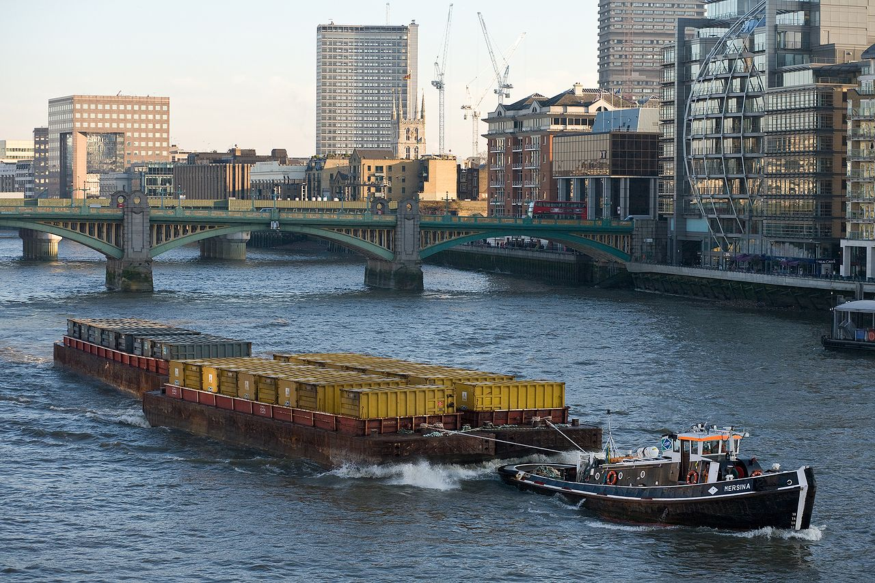
How do Rivers Impact Economic Activities?
Rivers are used primarily for transportation.
Rivers are not the fastest transportation mode but is more cost-effective.
Example: Hudson River connects to the Erie Canal which connects to the Great Lakes

Slide 5
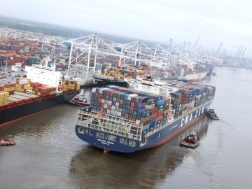
How do Seaports Impact Economic Activities?
Seaports are a city or town that is on the coast and has a harbor for ships.
  Because of the coast, many people are employed in shipping economy
Shipping is cheap but takes a long time and they are always a break of bulk point.
Seaports are a large part of foreign trade rather than domestic.
Example: Savannah is still a seaport receiving goods from Europe.

Slide 6
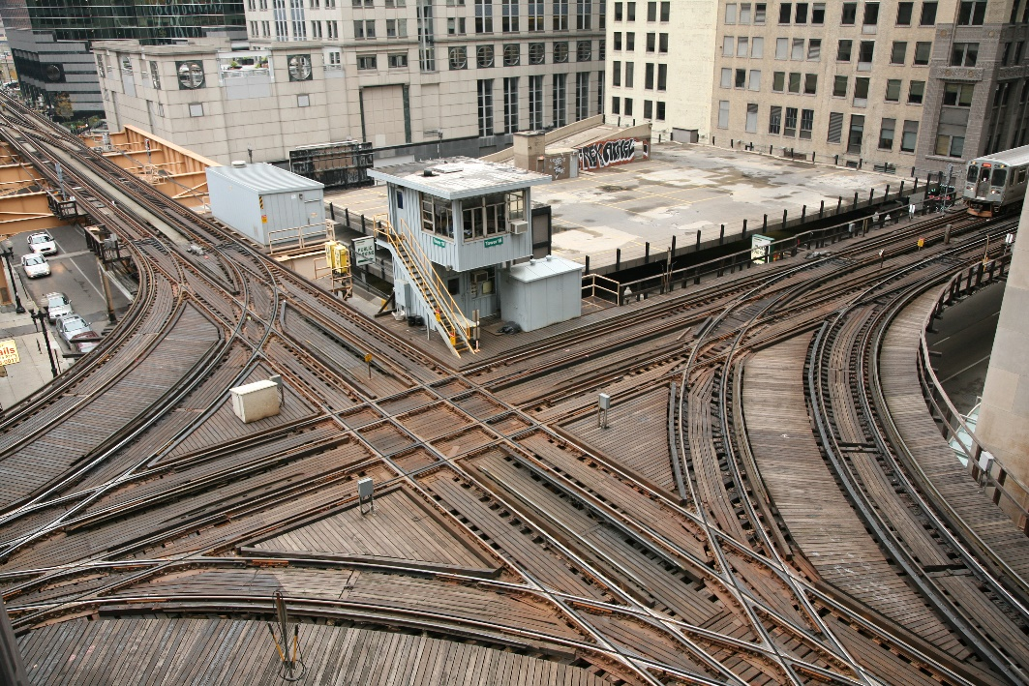
How do Transportation Hubs Impact Economic Activities?
Transportation hubs are areas where a certain mode of transportation is centered
  Think about a bike tire—all the spokes go inward and are connected through the center
Transportation hubs are usually also large cities because of ease of access to goods.
Depending on the type of transportation it can create issues like pollution and traffic.
Example: Chicago & Atlanta for railroads

