Slide 1
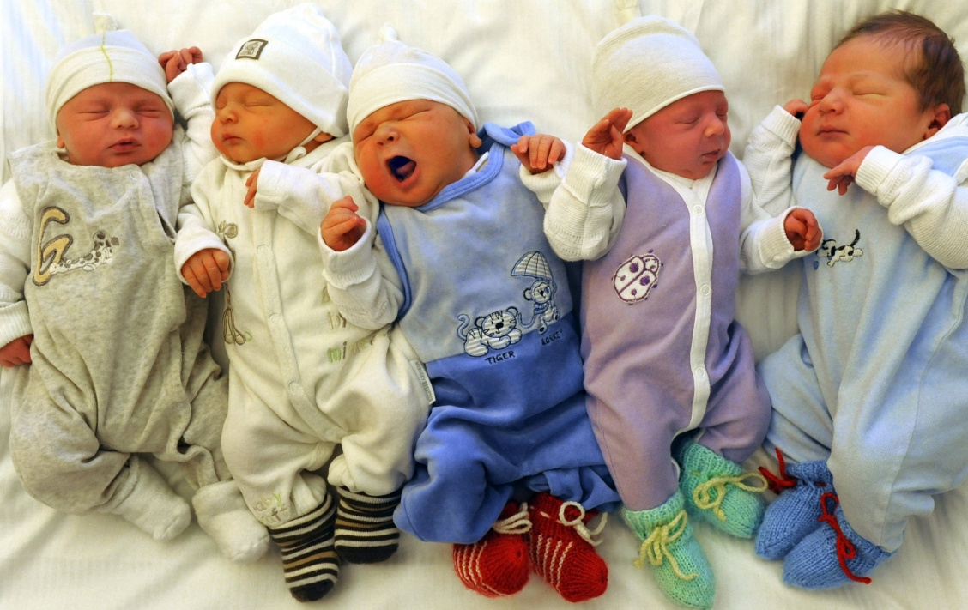
Pro & Anti Natalist Policies

Slide 2
Natalism
Countries around the world face problems from populations that are either growing too fast, or which are slowly shrinking.
Countries with LOW birthrates try to promote their people to have babies by instituting PRO-NATALIST POLICIES
Countries with HIGH birthrates try to curb the amount of children being born by instituting ANTI-NATALIST POLICIES

Slide 3
Reasons to control population
Why would you have a pro-Natalist Policy?
Why would you have an anti-Natalist policy?
Not enough workers to fill jobs
Too many people migrating out
Too many old people to care for
Country doesn’t have enough money to support it
Keep a country’s culture
Overpopulation
Might run out of resources
Not enough space
Too expensive to support the population
Too many people, not enough jobs

Slide 4
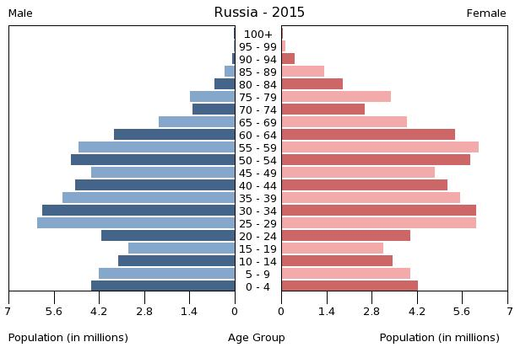
Russia
Pro-natalist
Specifics
Many people in Russia were not having children because of an uncertain future
Putin’s plan
Feeds into Russian traditions and culture.
Most important, this plan specifically targets people of European descent.

Slide 5
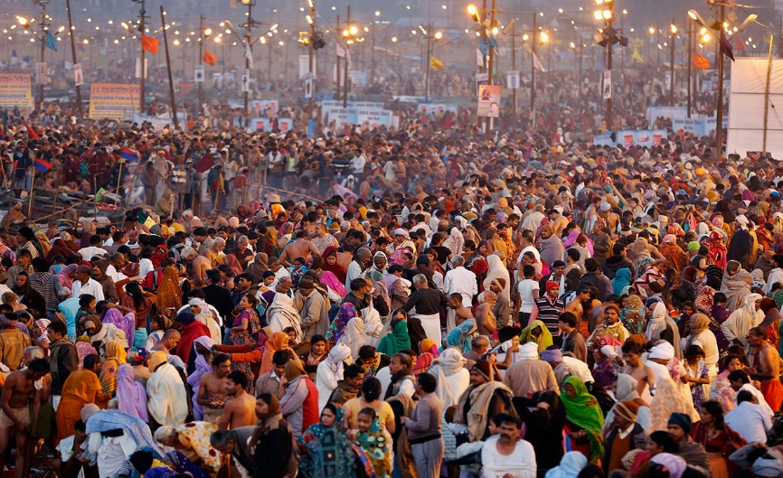
India
Anti-natalist
Specifics
India has more than a billion people and a high birth rate.
1950 – started family planning and encouraging smaller families.
In the 60s and 70s, India tried to lower its birthrate through a program of forced sterilization
Now offering incentives for people to get sterilized after having only a few children
Notes:
India's Hindu extremist party, the VHP, has asked the government to enforce family planning measures on the Muslim population, saying its rapid increase is "detrimental" to Hindus in the country

Slide 6
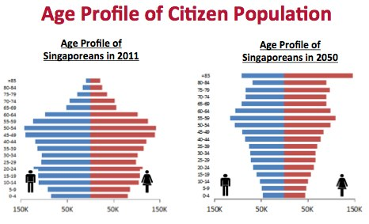
Singapore
Goal? Was anti but now pro
Specifics
Had high birth rate & fertility rate– made family planning available & gave financial rewards for smaller families
Currently, insufficient # of workers & there is an aging population
Now pro-Natalist with some incentives for people to get married and have kids like matchmaking services, baby bonuses, and increase fathers’ time off.

Slide 7
Maternity Leave around the world

Slide 8
Paternity Leave around the world

Slide 9
So Why does the U.S not do this?
Countries Tax Codes: Corporate-Income-Sales
Sweden 60/57/25
Germany 57/57/20
Australia 50/47/10
U.S 52/37/5

