Slide 1
Pollution

Slide 3
Pollution is any substance released into the environment that has harmful or poisonous effects.
Polluting substances reduce the ability of the natural environment to provide ecosystem services.
Pollution is often a side-effect of a process intended to benefit human beings.
Pesticides, for example, are designed to kill harmful insects that damage crops but they can also pollute our water and kill beneficial organisms such as bees. The loss of bees then reduces the amount of pollination that occurs, setting off a chain of negative effects in the environment.

Slide 4
Air Pollution
Air pollution refers to the contamination of the air, whether that be indoors or outside.
A physical, biological or chemical alteration to the air in the atmosphere can be termed as pollution.
It occurs when any harmful gases, dust, or smoke enters into the atmosphere and makes it difficult for plants, animals and humans to survive as the air becomes dirty.
These harmful gases also mix with the atmosphere to produce ACID RAIN which is especially problematic for forests and lakes.

Slide 5
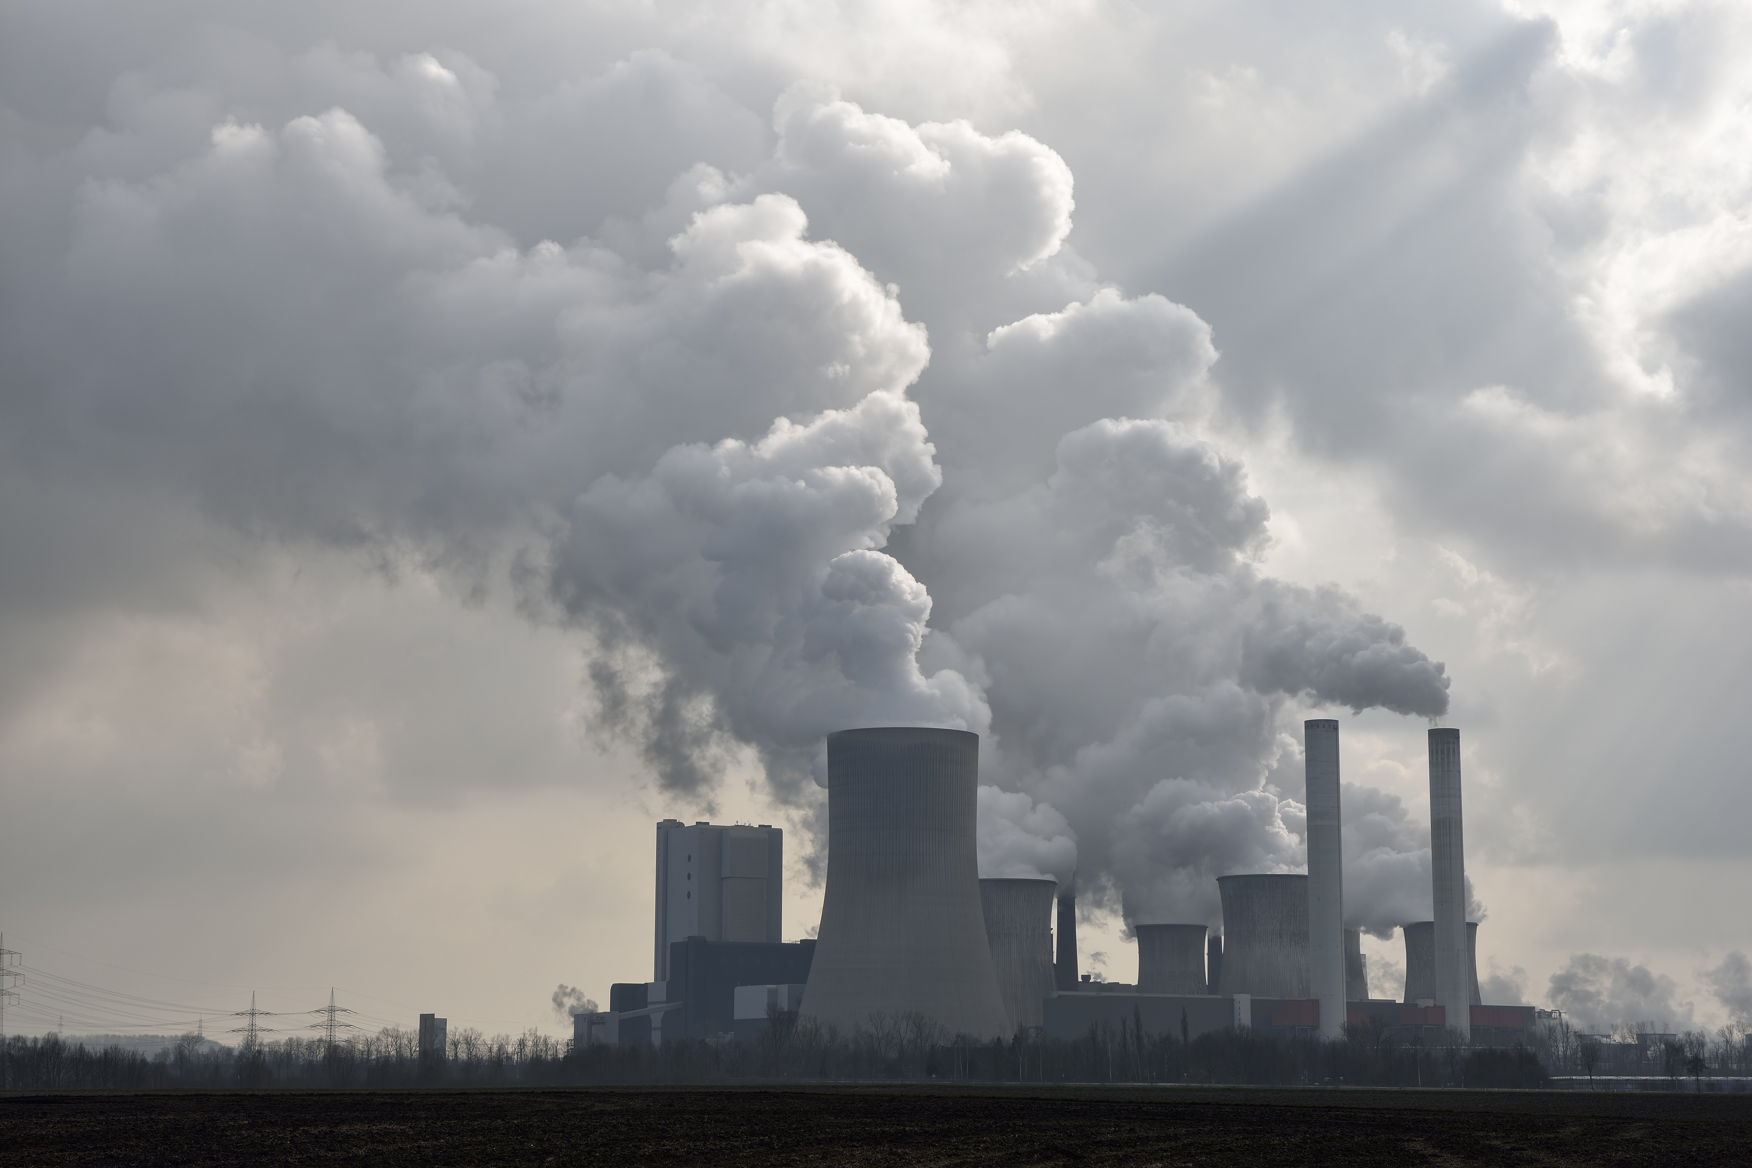
Causes of Air Pollution
1. Burning of Fossil Fuels: Sulfur dioxide emitted from the combustion of fossil fuels like coal, petroleum and other factory combustibles is one the major cause of air pollution. Vehicles including trucks, cars, trains, and airplanes cause immense amounts of pollution
2. Agricultural activities: Ammonia is a very common by product from agriculture related activities and is one of the most hazardous gases in the atmosphere. Use of insecticides, pesticides and fertilizers in agricultural activities has grown quite a lot. They emit harmful chemicals into the air.
3. Exhaust from factories and industries: Manufacturing industries release large amounts of carbon monoxide, hydrocarbons, organic compounds, and chemicals into the air thereby depleting the quality of air. Petroleum refineries also release hydrocarbons and various other chemicals that pollute the air and also cause land pollution.
4. Mining operations: Mining is a process wherein minerals below the earth are extracted using large equipment. During the process dust and chemicals are released in the air causing massive air pollution.

Slide 6
Effects of Air Pollution
Respiratory and heart problems: The effects of air pollution are known to create several respiratory and heart conditions along with cancer, among other threats to the body. Several millions are known to have died due to direct or indirect effects of air pollution. Children in areas exposed to air pollutants are said to commonly suffer from pneumonia and asthma.
Acid Rain*

Slide 7
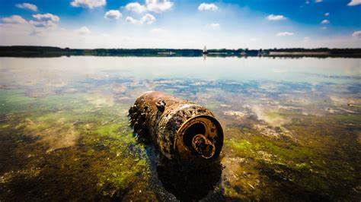
Water Pollution
Infested with waste ranging from floating plastic bags to chemical waste, our water bodies have turned into a pool of poison.
The contamination of water bodies in simplest words means water pollution. Thereby the abuse of lakes, ponds, oceans, rivers, reservoirs etc. is water pollution.
Pollution of water occurs when substances that will modify the water in negative fashion are discharged in it.

Slide 8
Causes/Effects of Water Pollution –
Industrial waste: Industries produce huge amounts of waste, which contains toxic chemicals and pollutants that can cause air pollution and damage to our environment. Many industries do not have proper waste management systems and drain the waste into the fresh water which goes into rivers, canals and later in to the sea. The toxic chemicals have the capability to change the color of the water, increase the amount of minerals, change the temperature of water and pose serious hazards to water organisms.
Sewage and waste water: The sewage and waste water that is produced by each household is chemically treated and released into the sea with fresh water. The sewage water carries harmful bacteria and chemicals that can cause serious health problems. The sewers of cities house several pathogens and diseases. Microorganisms in water are known to be causes of some very deadly diseases and become the breeding grounds for other creatures that act like carriers.

Slide 9
Mining activities: Mining is the process of crushing the rock and extracting coal and other minerals from underground. These elements when extracted in the raw form contains harmful chemicals and can increase the amount of toxic elements when mixed up with water which may result in health problems. Mining activities emit metal waste and sulphides from the rocks and can run off into water supplies.
Chemical fertilizers and pesticides: Chemical fertilizers and pesticides are used by farmers to protect crops from insects and bacteria. They are useful for the plants’ growth. However, when these chemicals are mixed up with irrigation systems and run off they become harmful. Also, when it rains, the chemicals mix up with rainwater and flow down into rivers and canals which pose serious damages for aquatic animals and plants.
Burning of fossil fuels: Fossil fuels like coal and oil when burnt produce substantial amount of ash in the atmosphere. The particles which contain toxic chemicals when mixed with water vapor result in acid rain. Also, carbon dioxide is released from burning of fossil fuels which result in global warming.
Accidental Oil leakage: Oil spills pose a huge concern as large amount of oil enters into the sea and does not dissolve with water. Oil spills cause many problems for local marine wildlife such as fish, birds and sea otters.

Slide 10
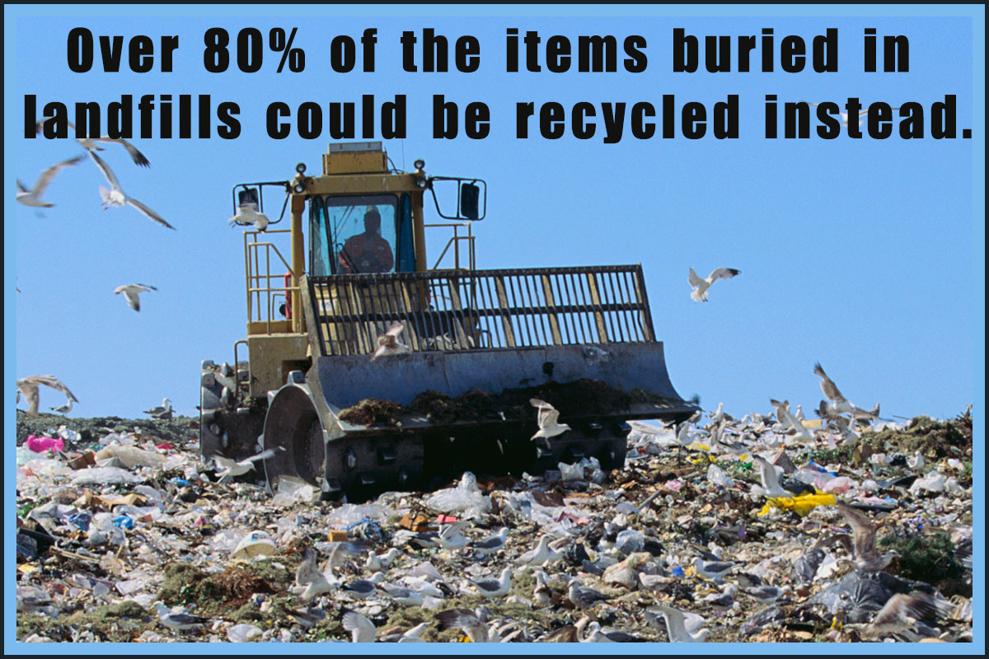
Land Pollution
Land pollution means degradation or destruction of earth’s surface and soil that lessens the quality and/or productivity of the land as an ideal place for agriculture, forestation, construction caused directly or indirectly by human activities.

Slide 11
Causes of Land Pollution –
Deforestation and soil erosion: Deforestation carried out to create dry lands is one of the major concerns. Land that is once converted into a dry or barren land, can never be made fertile again, whatever the magnitude of measures to redeem it are. Land conversion, meaning the alteration or modification of the original properties of the land to make it use-worthy for a specific purpose is another major cause. Also there is a constant waste of land. Unused available land over the years turns barren and then this land then cannot be used.
Agricultural activities: With a growing human population, demand for food has increased considerably. Farmers often use highly toxic fertilizers and pesticides to get rid of insects, fungi and bacteria from their crops. However, with the overuse of these chemicals, they result in contamination and poisoning of soil.
Overcrowded landfills: Each household produces tons of garbage each year. Garbage like aluminum, plastic, paper, cloth, and wood is collected and sent to the local recycling unit. Items that cannot be recycled become a part of the landfills that hampers the beauty of the city and cause land pollution.
Industrialization: Due to increase in demand for food and shelter more goods are produced. This resulted in creation of more waste that needs to be disposed of. To meet the demand of the growing population, more industries were developed which leads to deforestation. Research and development paved the way for modern fertilizers and chemicals that were highly toxic and led to soil contamination.
Sewage treatment: Large amount of solid waste is leftover once the sewage has been treated. The leftover material is sent to landfill sites, which ends up polluting the environment.

Slide 12
Effects of Land Pollution –
Soil pollution: Soil pollution is another form of land pollution, where the upper layer of the soil is damaged. This is caused by the overuse of chemical fertilizers, soil erosion caused by running water and other pest control measures; this leads to loss of fertile land for agriculture, forest cover, fodder patches for grazing etc.
Change in climate patterns: The effects of land pollution are very hazardous and can lead to the loss of ecosystems. When land is polluted, it directly or indirectly affects the climate patterns.
Environmental Impact: When deforestation is committed, the tree cover is compromised on. This leads to a steep imbalance in the rain cycle. A disturbed rain cycle affects a lot of factors. To begin with, the green cover is reduced. Trees and plants help balance the atmosphere, without them we are subjected to various concerns like the greenhouse effect, irregular rainfall and flash floods among other imbalances.
Effect on human health: When the land is contaminated with toxic chemicals and pesticides it can lead to problems such as skin cancer and human respiratory system issues. The toxic chemicals can reach our body through foods and vegetables grown in polluted soil.

Slide 13
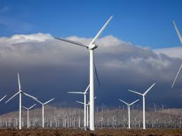
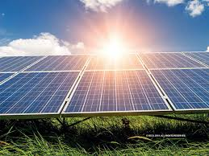
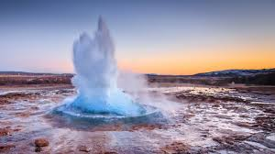
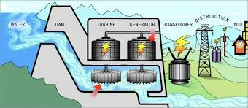
Sustainable Development
Sustainable Development- maintaining the continued ability of the surrounding environment to provide natural resources that the economy depends on and meet the development goals of society.
Sustainable land use can help to reduce the impacts of agriculture and livestock, preventing soil degradation and erosion and the loss of valuable land.
Alternative Energy- renewable energy sources that have lower carbon emissions. These include:
Wind Energy
Solar Energy
Geothermal Energy
Hydroelectric Energy

Slide 14
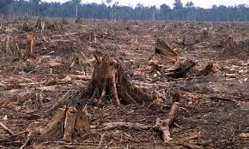
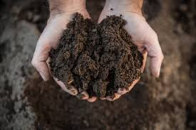
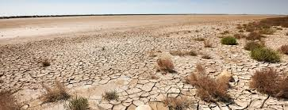
Depletion of Arable land
Arable Land- land that can be used to grow crops; many practices used in growing those crops can lead to the loss of topsoil and destruction of soil
The health of soil is a primary concern to farmers and the global community whose livelihoods depend on-well managed agriculture.
Degraded lands are less able to hold onto water, which can worsen flooding. As land loses its fertile soil, agricultural producers move on, clear more forest and continue the cycle of soil loss.
There are many challenges to maintaining healthy soil, including:
Deforestation
Overgrazing/Overfarming
Use of agrochemicals (pesticides, growth hormones, etc.)
Increased pollution
Desertification

