Slide 1
Population
SSWG4a. Assess demographic patterns of population using graphs, maps, and other models (e.g., Demographic Transition Model, population density maps, and global migration patterns).

Slide 2
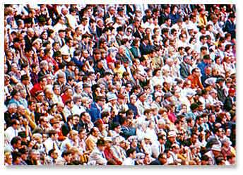
Demography: The Study of Population
Demography is critically important for three reasons:
The world’s population increased at a faster rate during the second half of the twentieth century than ever before in history.
Virtually all global population growth is concentrated in less developed countries.
More people are alive at this time – in excess of 7 billion—than at any time in human history.

Slide 3
DISTRIBUTION OF POPULATION
Population Concentrations
4 largest clusters
East Asia
South Asia
Southeast Asia
Western Europe
Why?
Water
Low lying/fertile land
10° -55 ° Latitude
Sparsely populated religions
Dry lands
Wet lands
Cold lands
High lands

Slide 4
Population pyramids
Population in a country is influenced in two principal ways: the percentage of the population in each age group, and the distribution of males and females.
A country’s population can be displayed by age and gender groups on a bar graph called a population pyramid.

Slide 5
Population pyramids
Questions to ask when looking at pop pyramids (TAGS):
Trends: Anything unusual or eye catching?
Ages: Where are the youth, adults, and elderly?
Gender: Is there equality or unusual proportions?
Shape: Is it a triangle, boxy, or inverted triangle?

Slide 6
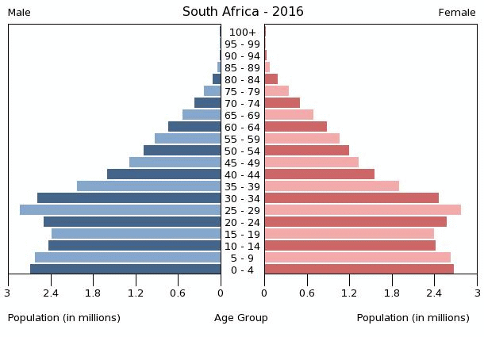
Population Pyramid 1

Slide 7
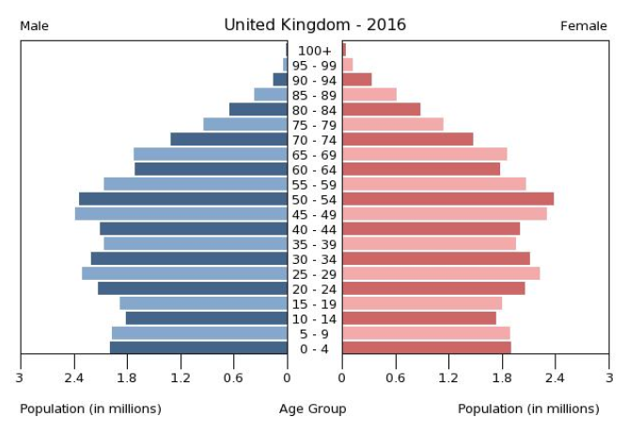
Population Pyramid 2

Slide 8
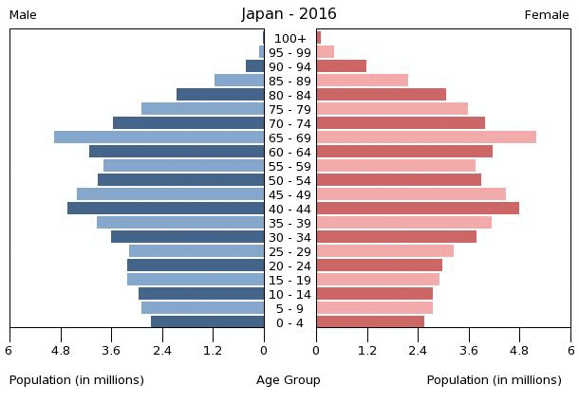
Population Pyramid 3

Slide 9
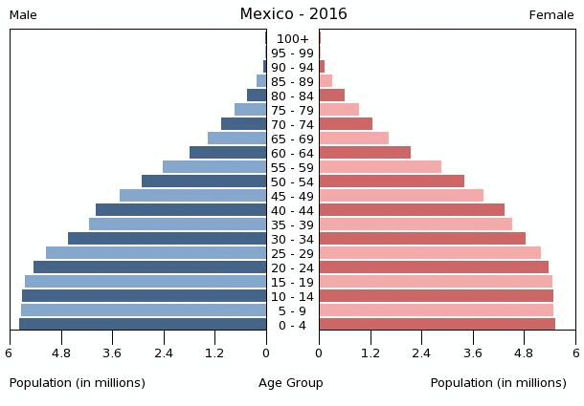
Population Pyramid 4

