Slide 1
The Geographer’s Eye
Latitude & Longitude

Slide 2
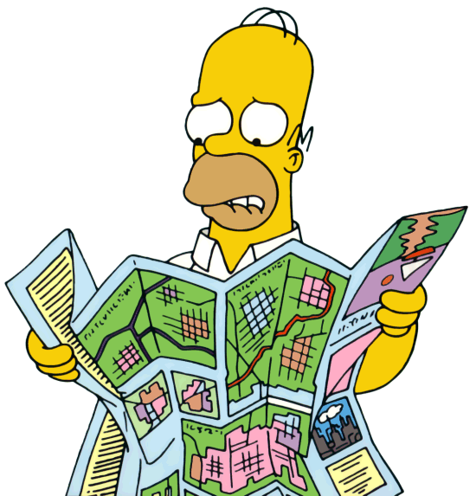
Essential ?
How do you use latitude and longitude to read map?

Slide 3
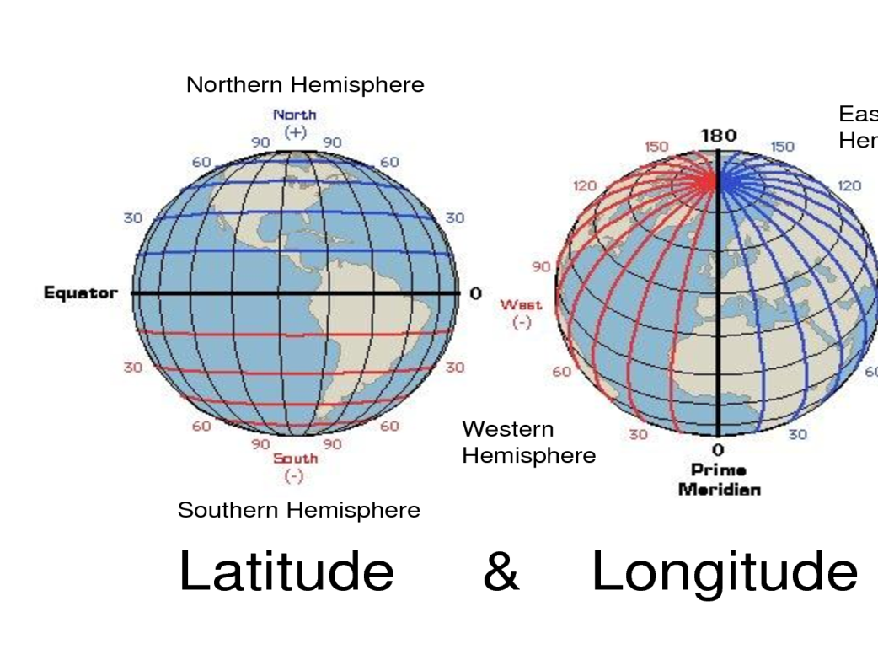
Vocabulary
Map – flat representation of Earth, or a portion of it.
Latitude – imaginary horizontal lines, running East & West, parallel to the equator, and measuring North & South of equator.
Longitude – imaginary vertical lines, running North & South, measuring distances East & West of the Prime Meridian.
Hemisphere – half a sphere or object.

Slide 4
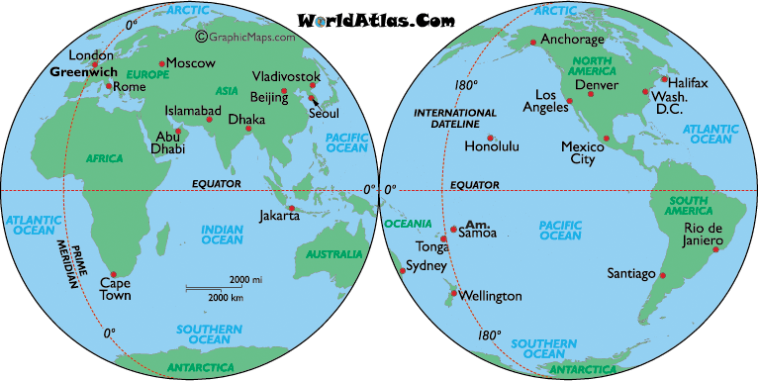
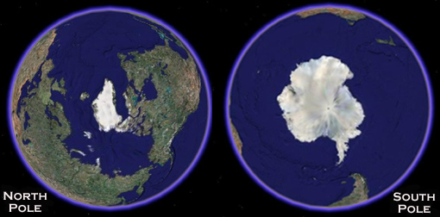
Vocab. Continued
Equator – measurement of 0* N/S, where the sun hits the Earth most directly.
Tropic of Cancer/Capricorn – where colder air descends back to Earth
Cancer – 23* N
Capricorn – 23* S
North/South Pole – farthest away from equator
North pole – 90* N
South pole – 90* S
Prime Meridian – 0* E/W
International Date Line – the opposite side of Earth from the Prime Meridian, measures at 180* E/W

Slide 5
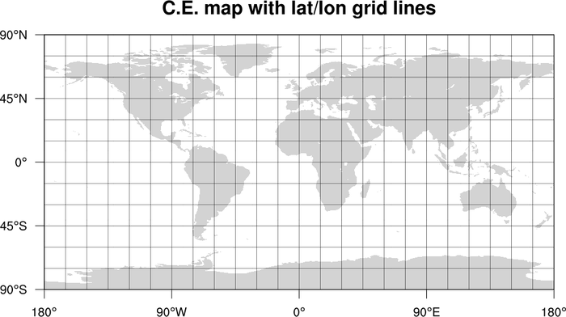
What is this???
Where have you seen something like this before?
Why would this graphic be helpful?

Slide 6
Assignment
Here are some random cities, plot them..
Beijing 39N 116E
Cairo 30N 31E
Hong Kong 22N 114E
Havana 23N 82W
La Paz 16S 68W
Manilla 14N 120E
Mexico City 19N 99W
Oslo 59N 10E
Prague 50 N 14E
Rio de Janiero 22S 43W
Vancouver 48N 126W

Slide 7
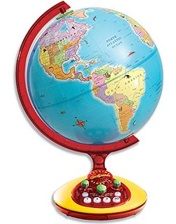
Vocabulary
VIDEO EXPLANATION
Globe – the most scaled model of Earth, true to Earth’s.
Size, Shape, Distance, & Direction
Mercator Projection – 1569, Used by Sailors, most accurate closest to the equator & most distorted in polar regions.
Peters Projection – 1885, is a rectangular map projection that maps all areas such that they have the correct sizes relative to each other.
Robinson Projection – 1988, most widely used map projection, uses the best characteristics while minimizing distortion.

Slide 8
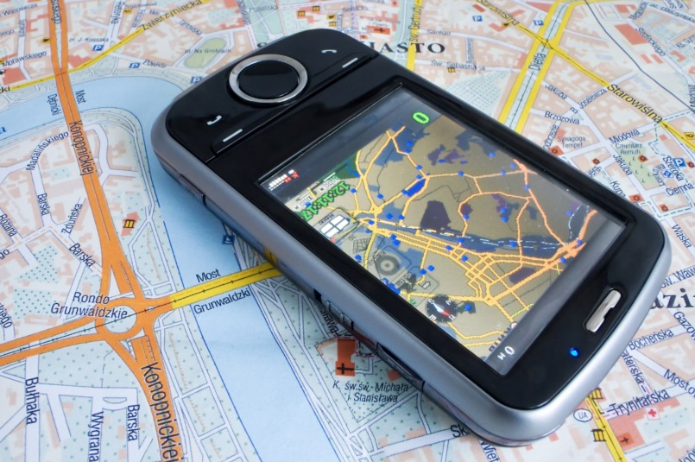
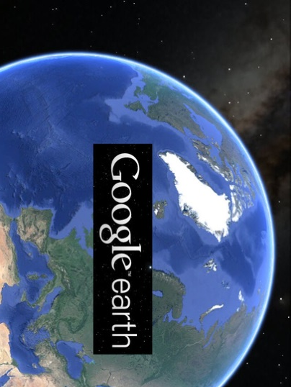
Vocab. Continued
Map Properties – size, shape, distance, or direction.
Global Information System (GIS) – technological application allowing the user to create new maps, analyze patterns and spatial relationships, and predict possible trends.
Global Positioning System (GPS) – utilizes data (Latitude, longitude, elevation, and time) are communicated via a device that receives data directly from satellites.

Slide 9
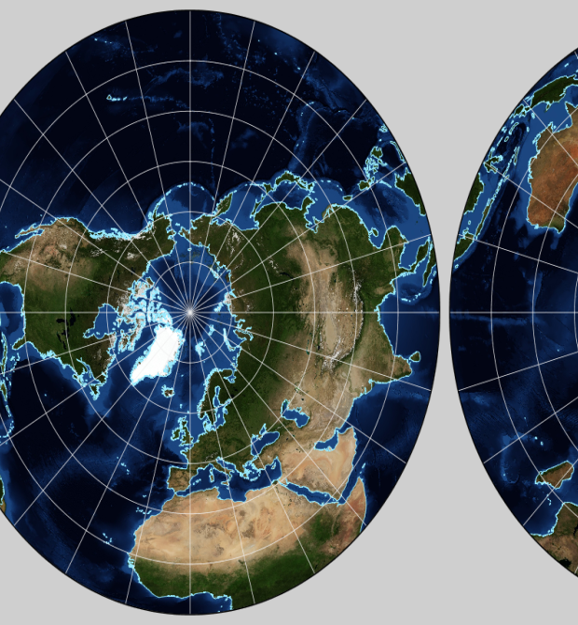
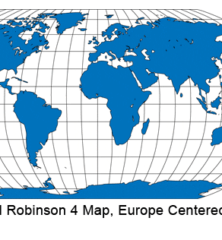
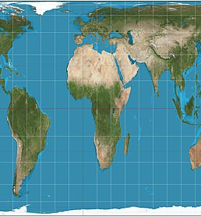
Class Discussion
What is similar about the maps?
What are the differences between the maps?
Why is there distortion on all of the maps?

