Slide 1
Introduction to Agriculture
SSWG5a. Describe how and why agricultural techniques and technology have changed over time (e.g., irrigation, crop rotation, green revolution, and GMO’s).

Slide 2
Before Agriculture
Before agriculture people found food through:
Hunting: killing animals to eat
Gathering: picking existing plants to eat
Nomadic lifestyle
When food sources ran out then people would move to somewhere else.

Slide 3
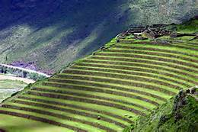
1st Agricultural Revolution
10,000 years ago
Humans first planted and harvested edible plants and domesticated wild animals
Allowed them to stop moving around and settle down
Early agricultural regions
Mesopotamia, China, Central America, Egypt, India
New Ideas
Irrigation, Plowing, Fencing, Terracing,
Fertilizing

Slide 4
1st Agricultural Revolution

Slide 5
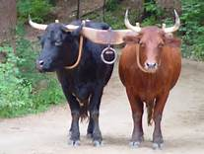
2nd Agricultural Revolution
Began in Western Europe in the 1600s
Promoted higher yields per acre and per farmer
New ideas
Crop rotation
Increased use of fertilizers,
New technology
Seed drill
Collars for draft animals
Fertilizers

Slide 6
2nd Agricultural Revolution

Slide 7
3rd Agricultural Revolution/Green Revolution
Green Revolution: 1960s and continues today
Began in the US
Introduced and diffused hybrid strains of grains by cross pollinating
Miracle rice and wheat
Mature in shorter amount of time
Reduced famines due to crop failure

Slide 9
GMOs vs. Organic Agriculture
Genetically Modified Organisms (GMOs) – Crops that carry new traits that have been inserted through advanced genetic engineering methods
GMOs are positive because they are resistant to diseases and insects and grow bigger and/or faster.
Some people do not like GMOs because they are not natural so there is also a push for more organic food options.

Slide 10
Genetically Modified Organisms (GMOs)

Slide 11
Positive Impacts of Agriculture Today
Provides food for the world
Countries can be self sufficient/economic gains
New technology can support more crops
GMOs are disease resistant and grow faster
New varieties of foods/hybrids
Some foods are cheaper and more plentiful
Organic options

Slide 12
Negative Impacts of Agriculture Today
Soil erosion
Water shortages
Dependency on chemicals for production
Changes in seeds
Cost
Overuse of land
Health issues

Slide 13
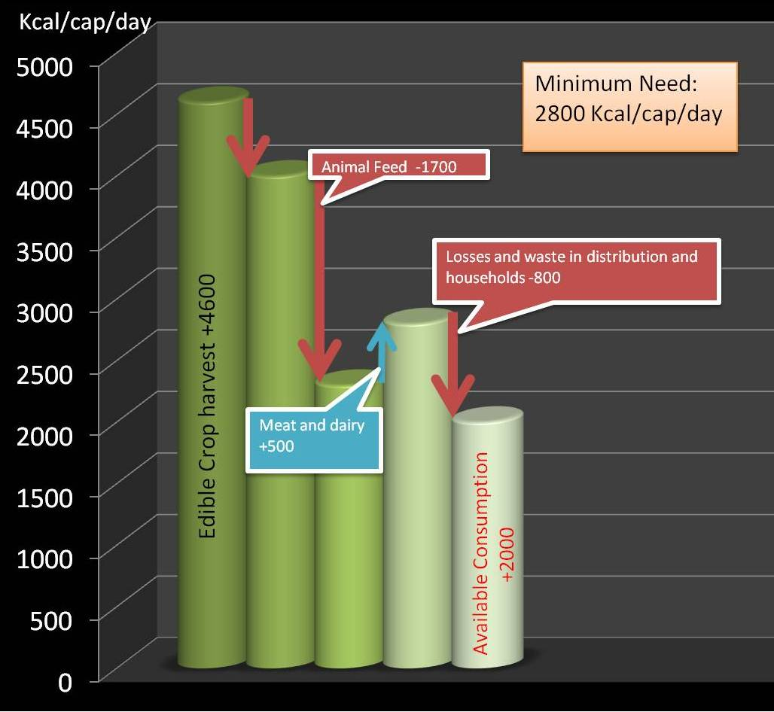
Inadequate Food Distribution Systems Enough food is produced worldwide to feed all the people in the world However, despite this alarming truth, nearly 1 billion people are suffering from chronic hunger today. There are a wide range of factors that contribute to this problem, but perhaps one of the most significant is poor food distribution

