Slide 1
The Demographic Transition Model

Slide 2
Stage 1: Low Growth
Birth Rate is high as a result of:
Lack of family planning
High Infant Mortality Rate
Need for workers in agriculture
Children as economic assets
Death Rate is high because of:
High levels of disease
Famine
Lack of clean water and sanitation
Lack of health care
War
Lack of education
BR and DR are both very high and relatively equal
RNI is almost 0
BR and DR widely change from year to year
Primarily seen in hunter-gatherer societies
NO COUNTRIES ARE HERE TODAY

Slide 3
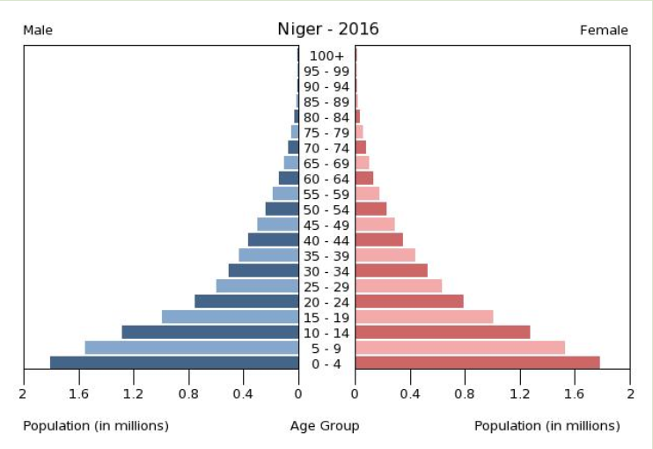
Stage 2: High Growth
Death Rate is falling as a result of:
Improved health care (e.g. Smallpox Vaccine)
Improved Hygiene (Water for drinking boiled)
Improved sanitation
Improved food production and storage
Improved transport for food
Decreased Infant Mortality Rates
DR drops dramatically
BR still high
RNI increases rapidly

Slide 4
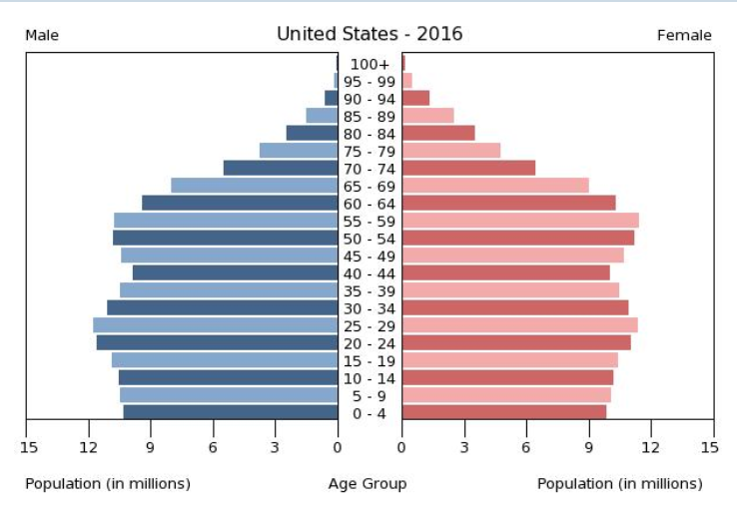
Stage 3: Moderate Growth/Late Expanding
BR starts to decline while DR continues to stay low
RNI is much slower growth
Reasons:
Family planning available
Lower Infant Mortality Rate
Increased mechanization reduces need for workers
Increased standard of living
Changing status of women

Slide 5
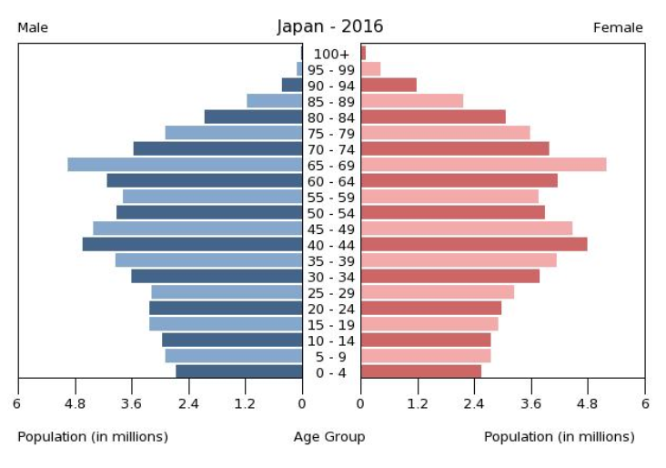
Stage 4: Low Growth
A country reaches this point when the BR and DR low are almost equal leading
RNI of almost 0 (Zero Population Growth) or close to Negative Population Growth.
Reasons for Change:
Women in workforce instead of home
Availability of Birth Control
Changes in leisure activity not suitable for couples with children (bars, travel)
Higher education levels
Pessimism about future

